Slide 1
MICRO CREDIT DEFAULTER PROJECT
FLIP ROBO
BY PRACHI PARMAR

Slide 2
PROBLEM STATMENT
A Microfinance Institution (MFI) is an organization that offers financial services to low income populations. MFS becomes very useful when targeting especially the unbanked poor families living in remote areas with not much sources of income. The Microfinance services (MFS) provided by MFI are Group Loans, Agricultural Loans, Individual Business Loans and so on.
Build a model which can be used to predict in terms of a probability for each loan transaction, whether the customer will be paying back the loaned amount within 5 days of insurance of loan. In this case, Label ‘1’ indicates that the loan has been payed i.e. Non- defaulter, while, Label ‘0’ indicates that the loan has not been payed i.e. defaulter.

Slide 3
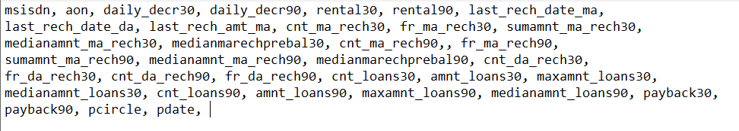
INFORMATION ON DATA
How it works:
Data Attributes : 35 Features, 1 Target Variable
Target Variable: Defaulter label ‘0’ / Non Defaulter label ‘1’ i.e Defualter being did not repay the loan, and non-Defaulter being repayed the loan.
Features: See The picture below.

Slide 4
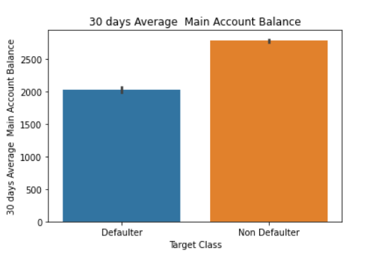
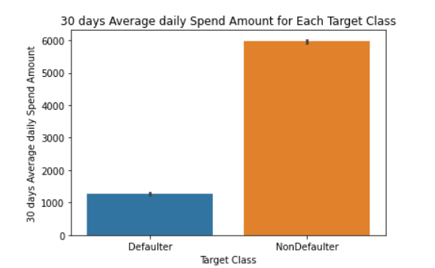
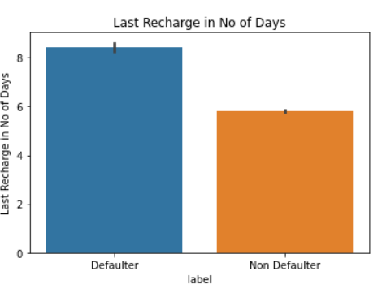
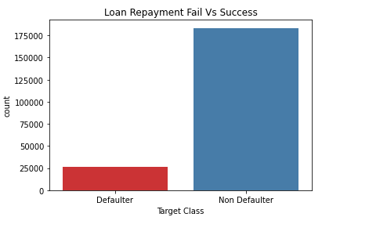
EXPLORATORY DATA ANALYSIS
EDA for Each Feature vs the Target Varaible gives Following insights. that:
Main Account Balance 30/90, average daily spent amount 30/90 average is higher for non-Defaulters than Defaulters as you can see .
Total Loan Amount, Last recharge Amount were higher for non-defaulters than defaulter.
High Count of loans taken were for Non Defualters and not defualters.
Features like pcircle, pdate, msisdn have no influence on Target Variable and hence can be dropped.
Target classes are imbalanced as you Can see in the Picture.

Slide 5
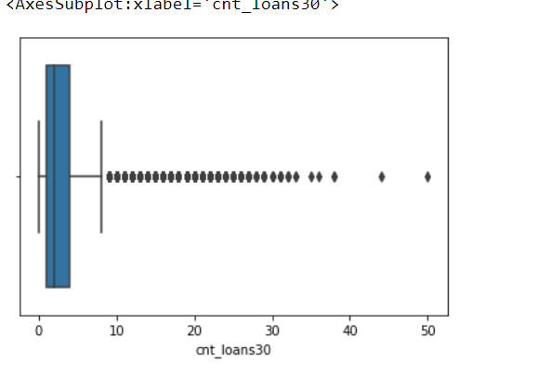
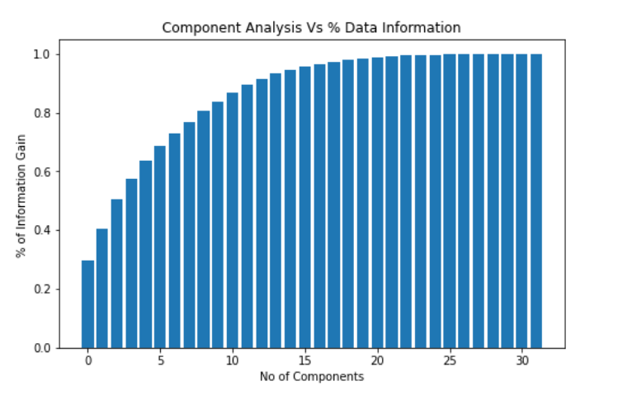
DATA CLEANING STEPS
Steps of data cleaning followed are as below:
1
As many unrealistic values were present, converted does values to np.Nan and dropped Null Values with 5.2% data loss.
After performing statistical methods to detect outliers and visualization with boxplots as you can see. These data points may seem like outliers mathematically but these outliers datapoints significantly belongs to Non Defaulters and tells us about the Target Variables and is meaningful Data. We cannot remove these outliers
2
3
We have Skewed Data, which can be reduced and scaled with Power Transformer as outliers wont be effected with power transformer. Then PCA is performed to see how many components needed to predict Target.

Slide 6
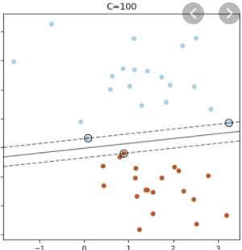
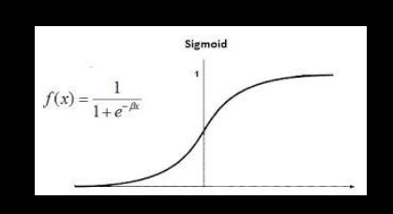
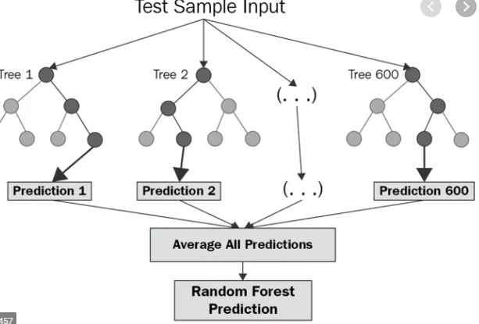
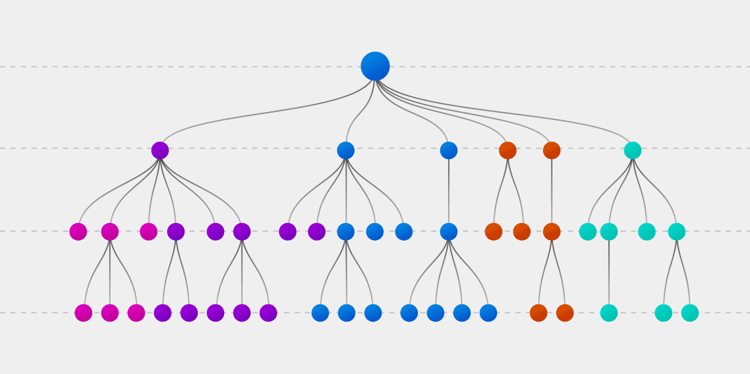
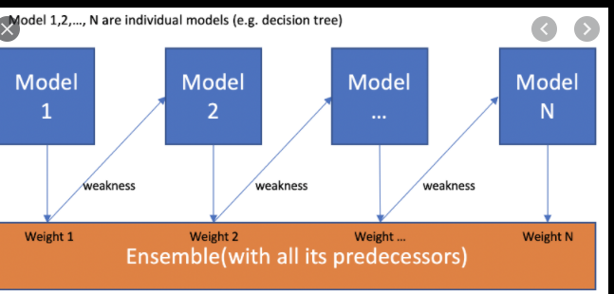
MODELING THE DATA
Following Models were used for Modeling the Data.
4
LINEARSVC
2
LOGISTIC REGRESSION
3
ENSEMBLE TECHNIQUES
RANDOM FOREST
ADABOOST
1
DECISION TREE

Slide 7
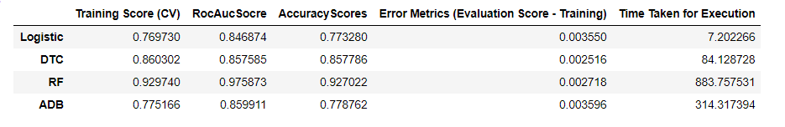
EVALUATION OF THE MODELS
As you can See, Random Forest and Decision tree has Lowest Error metrics but Random Forest has Highest Accuracy score with 97% roc Score and Accuracy score of 92%.
Choosen Model : Random Forest Model

Slide 8
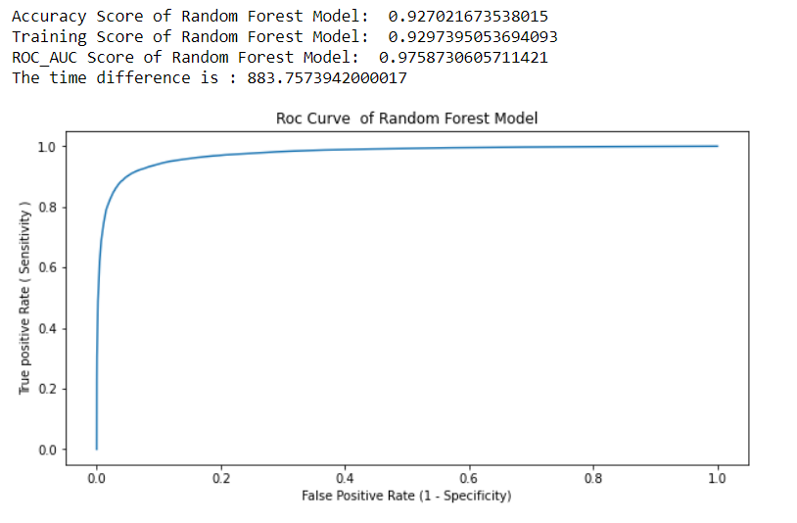
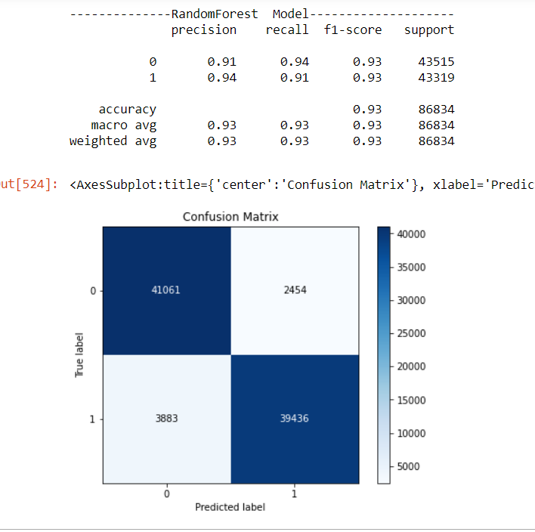
RANDOM FOREST METRICS EVALUATION

Slide 9
CONCLUSION
Micro Credit Defaulter Prediction predicts if the a customer will repay a loan is 5 days or not. After Visualization of the features and target variable. I conclude that random forest works best for this kind of problem statements with 92% accuracy score i.e % of total correct prediction and Roc_AUC score of 97% i.e prediction of true positive rate vs false positive rate .

Slide 10
THANK YOU

